Slide 1
Basic Biological Concepts
Multicellular Organisms
Section 3 – Lecture 1

Slide 2
Life Gets Bigger
As the first life forms evolved, some had mutations which made them larger
Why would being a larger single-celled organism be selected for by natural selection?

Slide 3
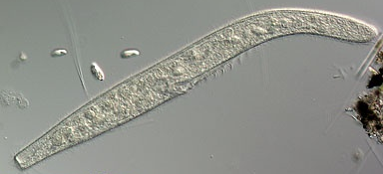
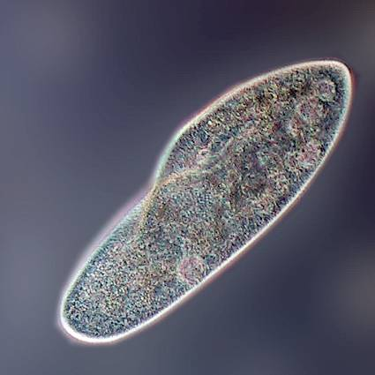
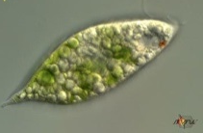
Bigger Can Be Better
Larger organisms are harder for smaller organisms to ingest (better for defense)
Being larger also means it is easier to ingest smaller organisms (better for predation)
Example: Spirostomum preys on paramecium, which preys on euglena
Euglena
Paramecium
Spirostomum

Slide 4
Bigger Can Also Be Harder
As organisms become larger, physics starts to work against them
The metabolic reactions occurring inside a cell consume O2 and nutrients, and generate CO2 and wastes
The surface of an organism is in contact with the environment and is used for diffusion of gases, nutrients, and wastes
The larger the volume gets, the more surface area is needed
However, as size increases the ratio between volume and surface area decreases

Slide 5
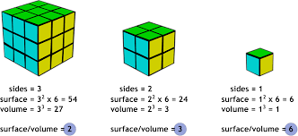
Single-celled organisms are limited in how big they can get
Surface Area to Volume ratio declines as organisms grow

Slide 6
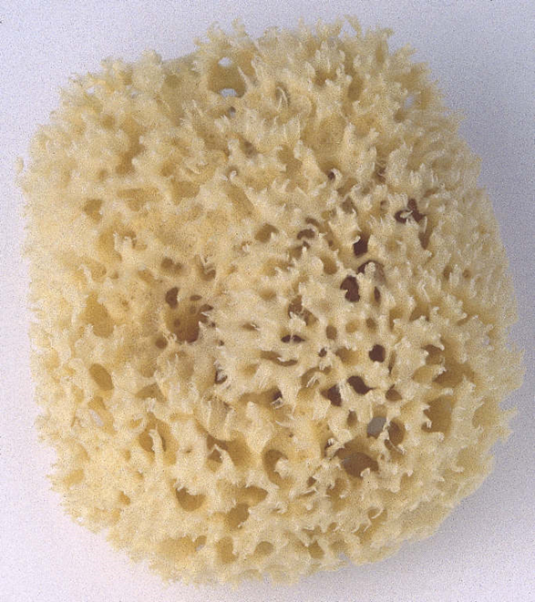
So, how did life take advantage of being bigger?
Although there can be advantages to being larger, there is an upper limit on how large a single cell can grow
One strategy adopted by organisms was to form colonies of cells
Colonies of cells are bigger than any single cell
Sponges are a good example of colonies of cells
Each cell lies close to the external environment

Slide 7
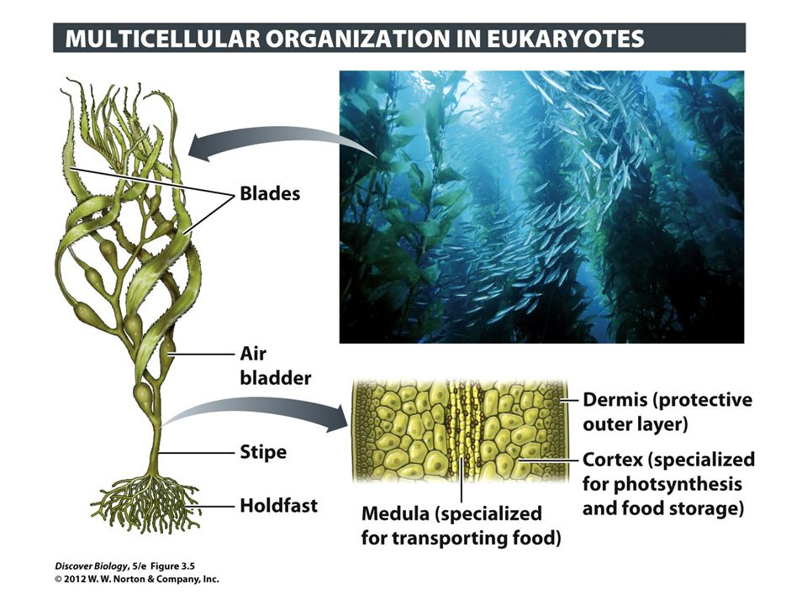
Relatively Simple Forms of Multicellular Life
Remember: Kelp forests are made up of multicellular protista

Slide 8
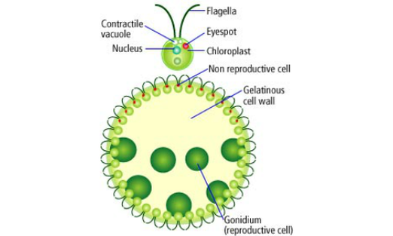
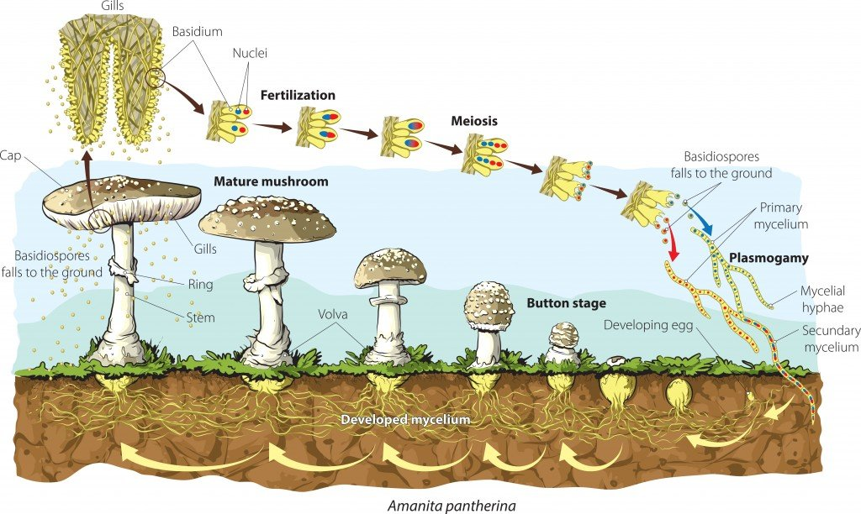
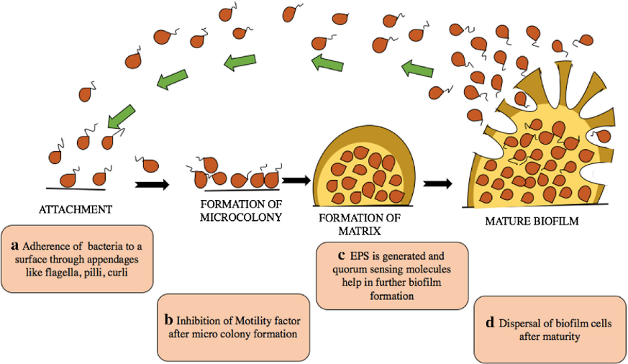
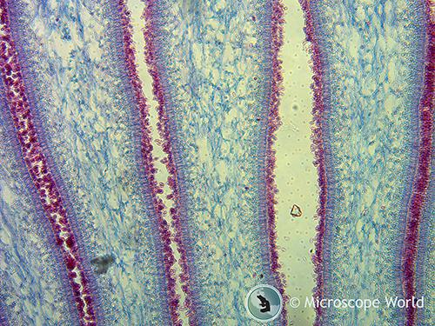
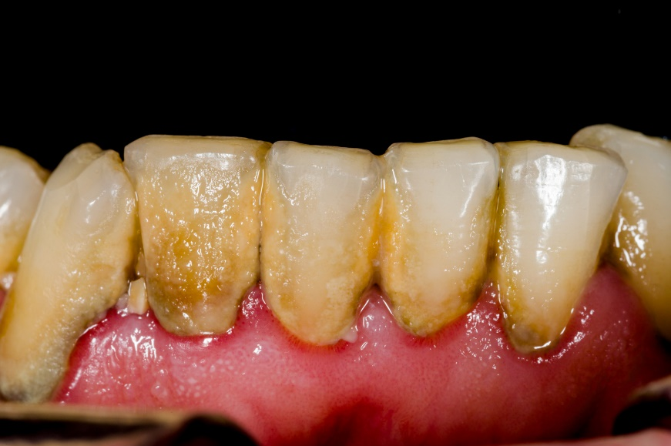
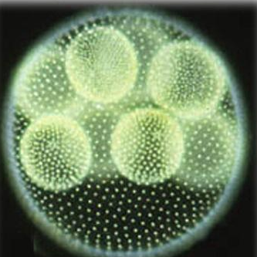
Relatively Simple Forms of Multicellular Life
Volvox: green algae
Fungi: mushrooms
Bacterial biofilm

Slide 9
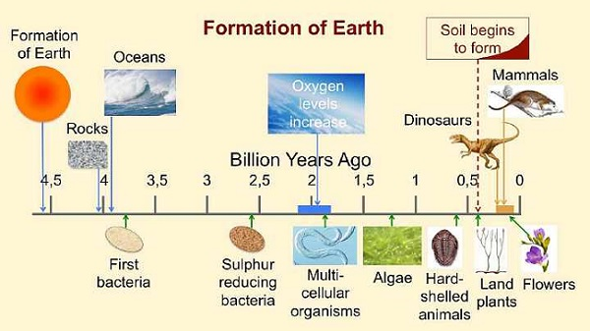
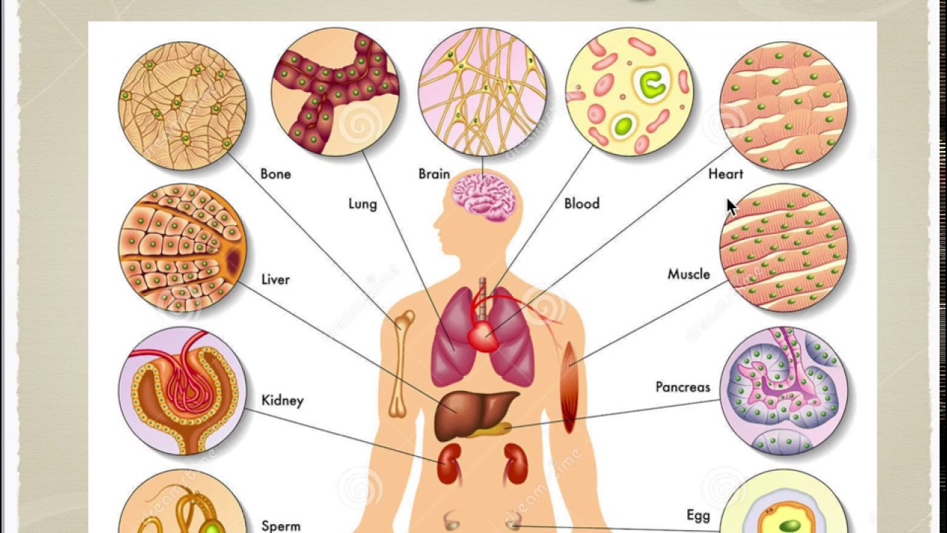
Multicellular Life
At some point, cells within colonies began to specialize to carry out specific tasks (e.g. acquiring nutrients, mobility, reproduction, etc.)
Once the cells in a colony have each reached a level specialization which causes them to rely on each other, it is considered a multicellular organism

Slide 10
Multicellular organisms face problems which single-cellular organisms don’t have….
Being strong enough to resist external forces and protect all cells in their preferred environment
Having enough surface area for diffusion to keep pace with all of the metabolism taking place
Transporting substances around the inside if the organism: nutrients, wastes, etc.
Coordinating the actions of all the cells within the organism

Slide 11
Regulation of Extracellular Structure
These extracellular materials are produced and organized by the cells themselves.
Extracellular structures keep the organism intact and allow coordinated function
Mechanical support and defense
Adhesion for cells and tissues
Substrate for cell and organismal movement
Regulation of cell growth and function

Slide 12
Animal cells secrete an elaborate extracellular matrix “ECM”
Vertebrate four compound ECM
Exoskeletal carapace in many arthropods
Plants, fungi and prokaryotes secrete a sugar “cell wall”
Cellulose cell wall in plant cells
Chitin in fungi
(Pseudo-) peptidoglycan in prokaryotes
Bacterial cells secrete “plaques”
Extracellular polymeric substance: DNA, protein and polysaccarides (including cellulose)

Slide 13
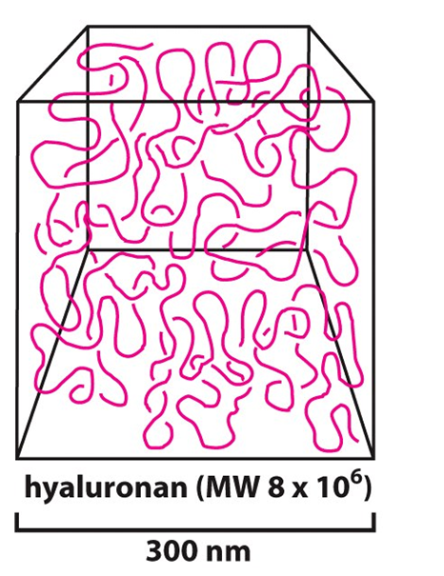
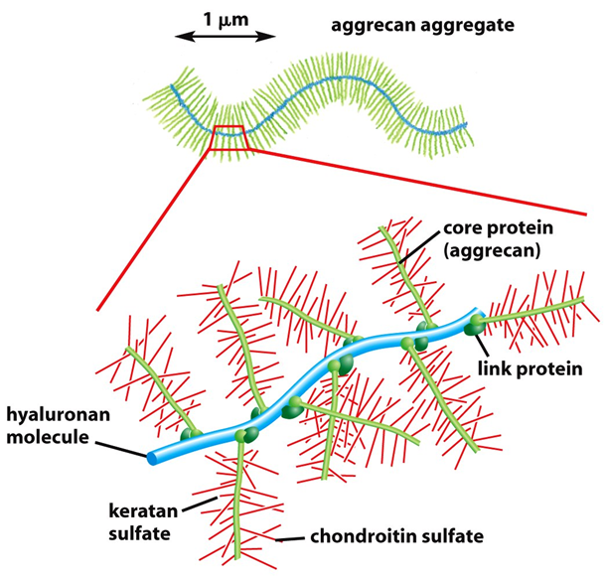
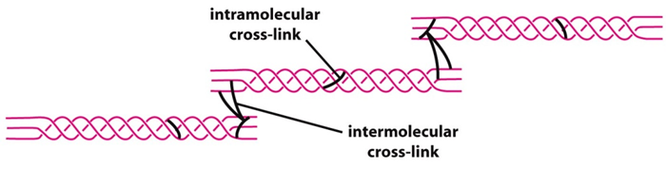
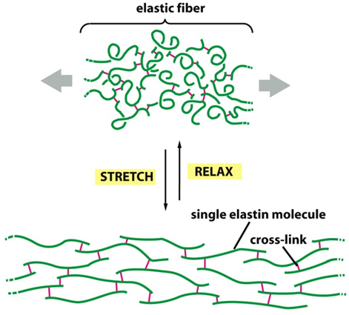
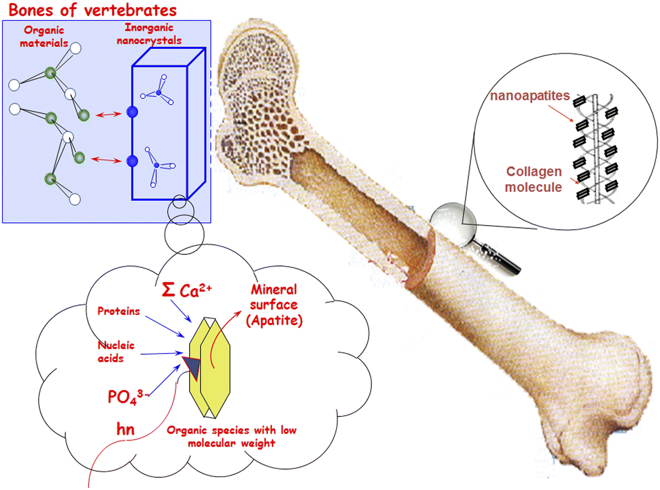
Variations in Animal ECM
Basic components in Vertebrates
Sugar Ground Substance: glycosaminoglycans (GAGs)
Protein Organizers: proteoglycans (PGs)
Tensile Strength: collagen, fibronectin, laminin
Tissue Flexibility: elastic proteins
Hardening Agents: Ca²⁺-apatite for bone
GAG sugars
GAG-PG complex
Cross-linked collagen support
Elastin fibers
Ca-Apatite deposits in collagen

Slide 14
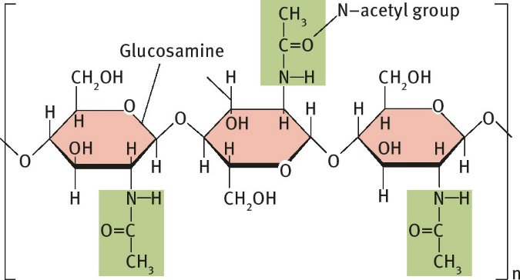
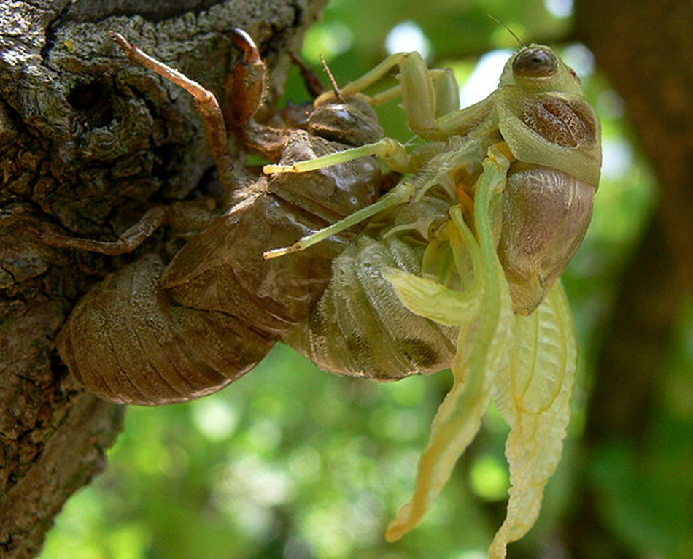
Variations in Animal ECM
Basic components in Arthropods
Sugar Ground Substance: chitin
Proteinaceous matrix: leathery structure
Hardening Agents: Ca²⁺-carbonate
Chitin: N-acetyl-glucosamine sugars
Many build “exoskeleton” to be discarded when outgrown

Slide 15
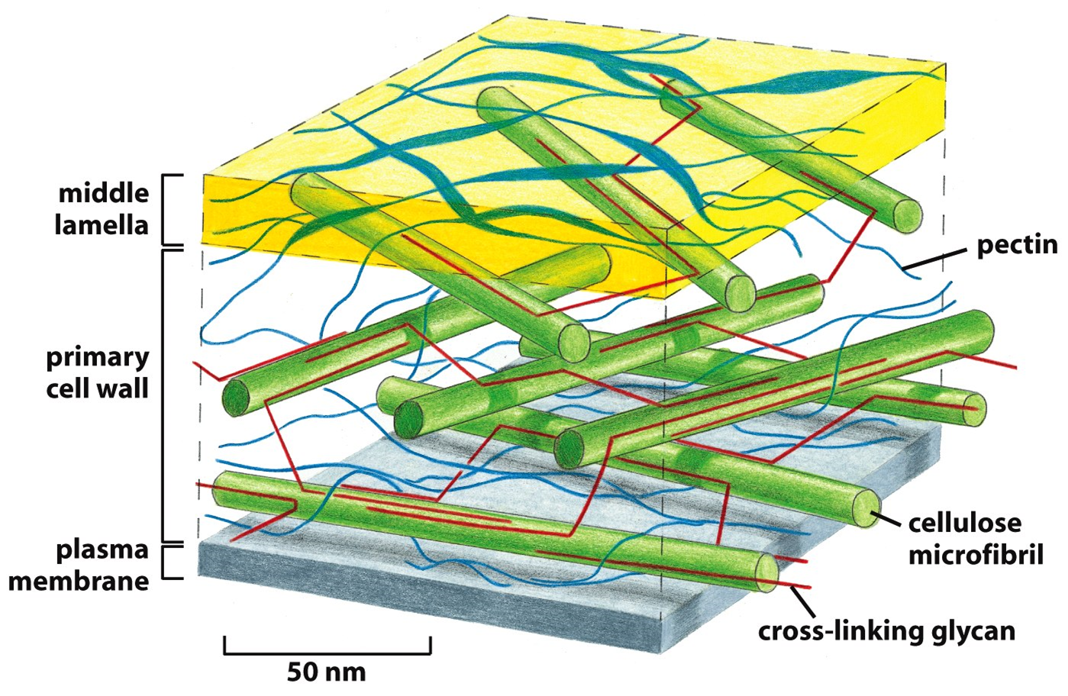
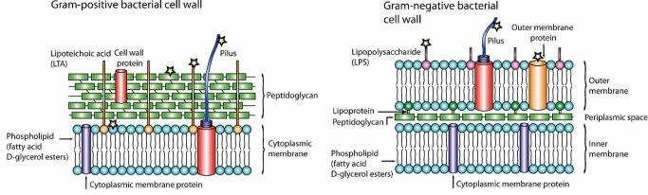
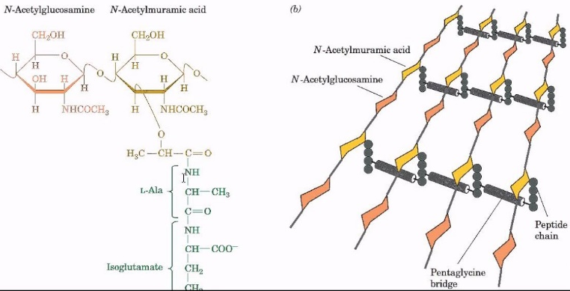
Variations in sugar cell walls
Plant Cell Wall
Plants/Algae
cellulose
pectin
cross-linking glycan
Fungi
Chitin (see Arthropods)
Prokaryotes
Bacteria: peptidoglycan
Archaea: pseudopeptidoglycan
Gram +/- Bacterial Cell Walls
Archeae Cell Wall

Slide 16
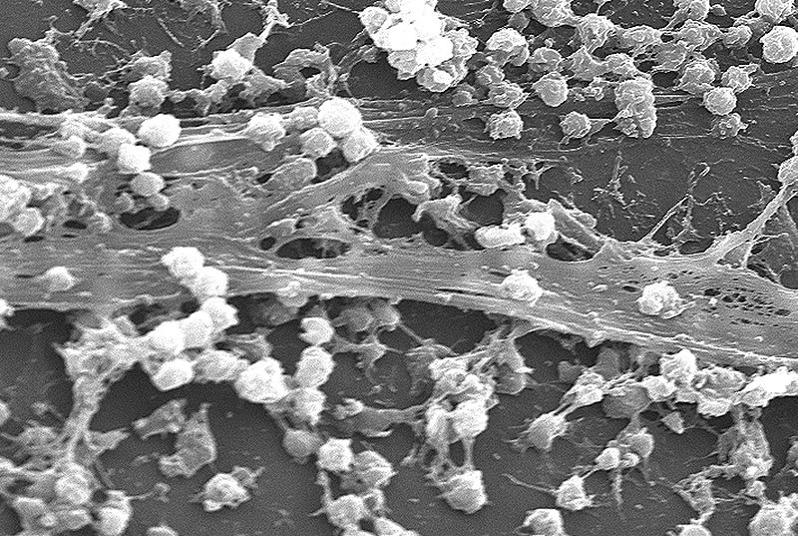
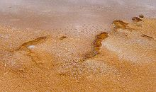
Bacterial Biofilms are ECM for Cell Populations
Cells become:
-adherent
-differentiated
-cooperative
Components:
-DNA
-proteins
-polysaccharides
(cellulose)

Slide 17
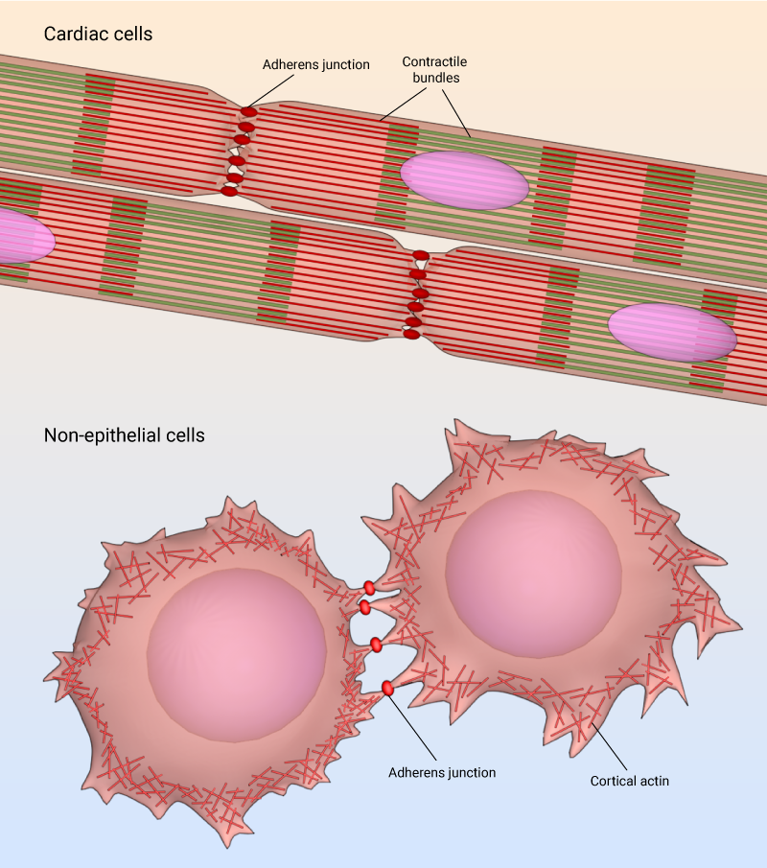
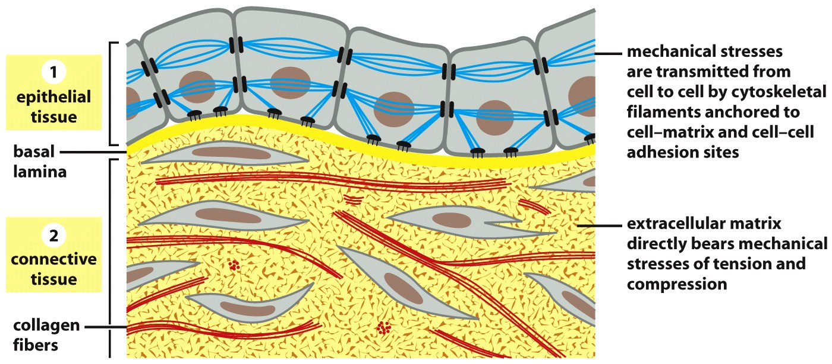
Regulation of Cell Adhesion
Most cells must adhere to survive – VERY few are free
Cells adhere to other cells, the ECM or both
Cells that lose their attachments to undergo anoikis, programmed cell death
Epithelial cell-cell and cell-ECM adhesions
Mesenchymal cell-cell adhesions

Slide 18
Cell Specialization
Cells of an organism share the exact same DNA but can be very different
There are over 200 cell types in adult humans
Cell types are determined by differential gene expression that is controlled by regulatory (non-coding) regions of DNA
Anatomical organization in multicellular organisms is based on cells
Tissues are made up of multiple cell types
Organs are made up of multiple tissue types
Systems are made up of multiple organs

Slide 19
Four Types of Vertebrate Tissue
Epithelial Tissues: barriers with specially-designed functions
Connective Tissues: gravitational strength and support, movement
Muscle: voluntary movement, pumping blood, movement of materials
Nervous Tissues: movement, sensation, control of homeostasis

Slide 20
Epithelial Structure Equals Function
Examples:
Skin: barrier to the outside world, waterproofing, rapid injury response, immunity
Small Intestine: barrier to intestinal contents, digestion and absorption, immunity
Trachea: barrier to airway contents, removing micro-organisms and debris, immunity
Blood Vessel Wall: blood and tissue barrier, gas/fluid exchange, immunity

Slide 21
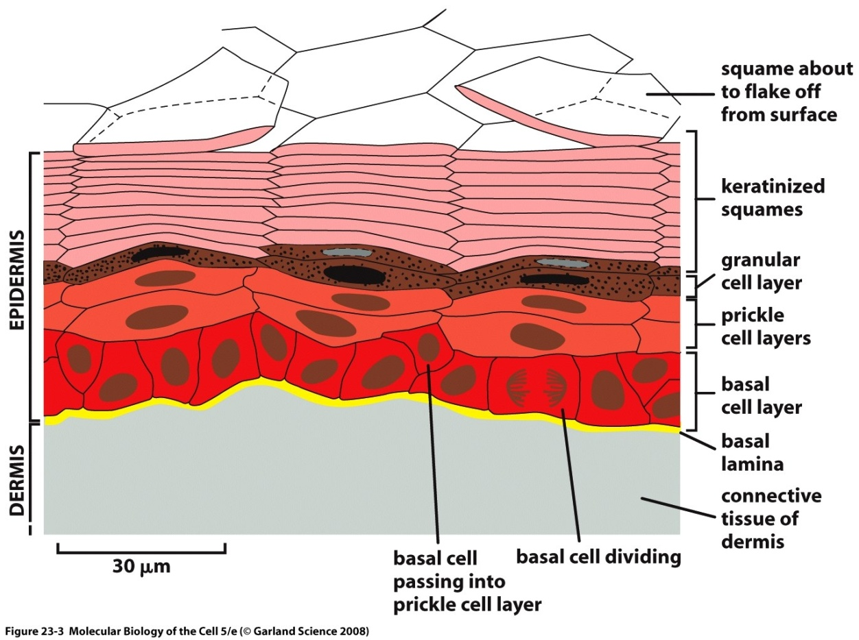
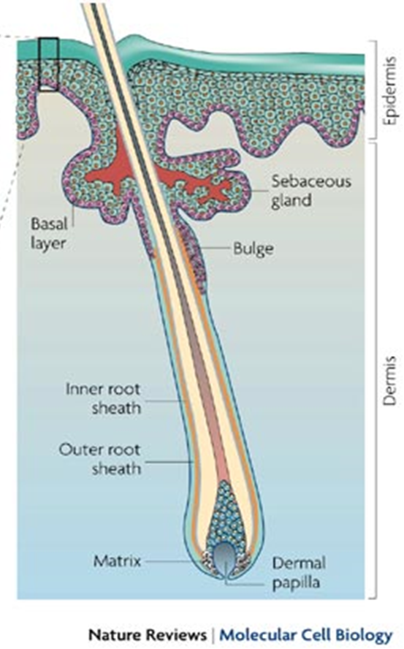
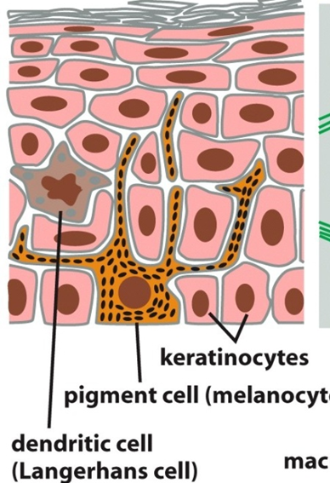
Skin: barrier to the outside world, waterproofing, rapid injury response, immunity
“Stratified Squamous Epithelium”
Cornification is the over- production of cytokeratins, ECM and the adhesions to a degree that stops cellular metabolism.
UV barrier
Waterproofing

Slide 22
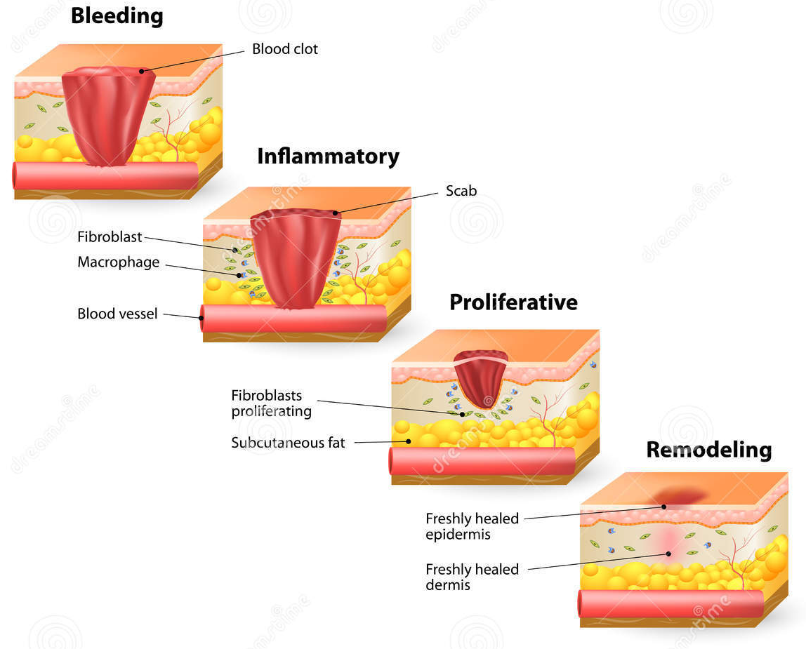
The uncontested champion for speed of healing

Slide 23
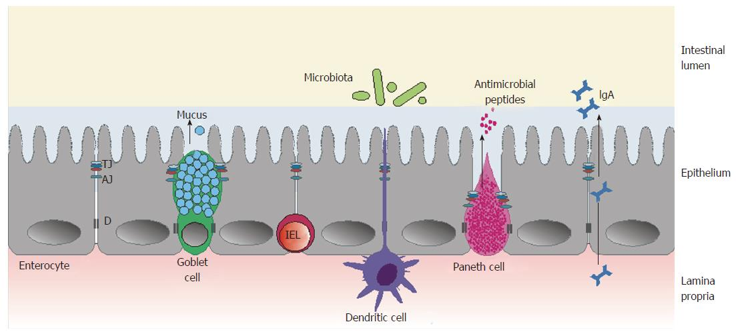
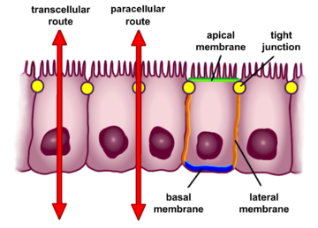
Small Intestine: barrier to intestinal contents, digestion and absorption, immunity
“Simple, Columnar Epithelium”
Functions:
absorption of nutrients
enzymatic digestion at neutral pH
multiple defensive mechanisms

Slide 24
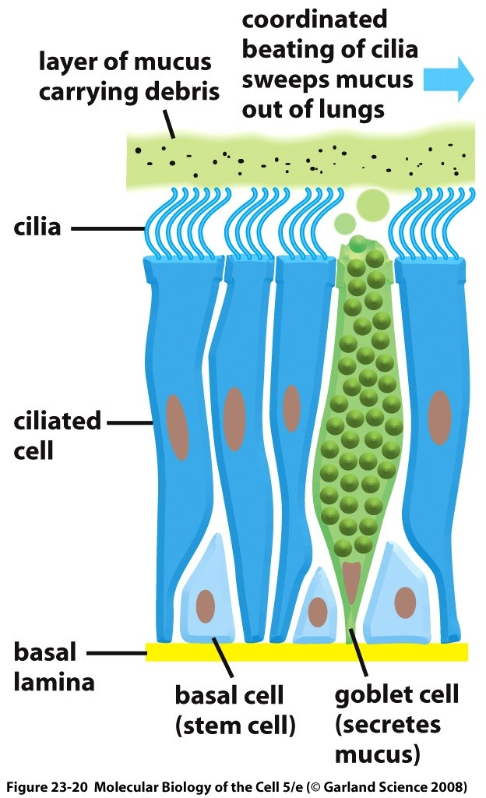
Trachea: barrier to airway contents, removing micro-organisms and debris, immunity
Mucus traps dust and air-borne microorganisms
Ciliar waving gets rid of unwanted material
“Ciliated, Pseudostratified, Columnar Epithelium”

Slide 25
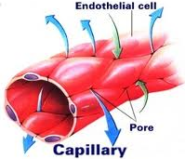
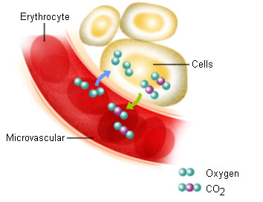
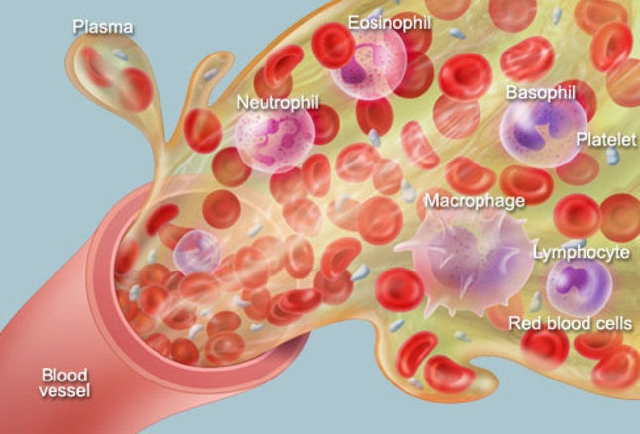
“Simple, Squamous Epithelium”
Blood Vessel: barrier between blood and tissues, gas/fluid exchange, immunity
Fluid Exchange
Gas Exchange
Immune Cell Monitoring

Slide 26
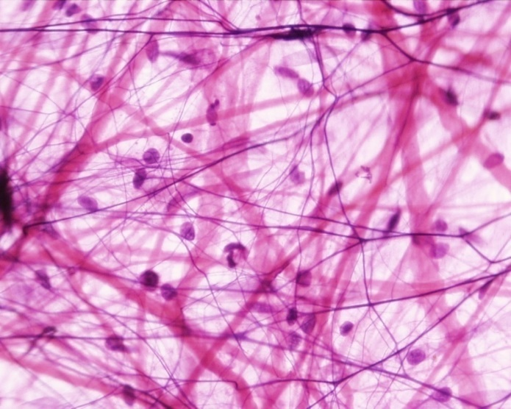
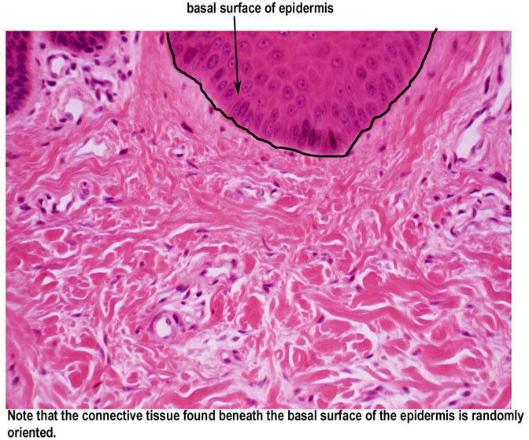
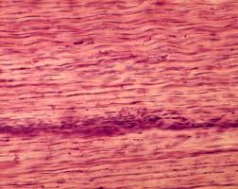
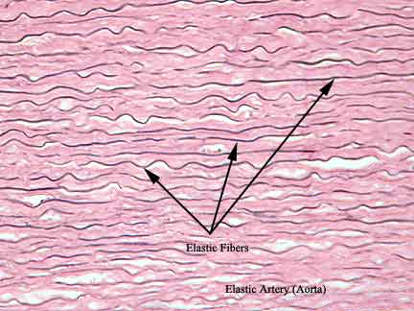
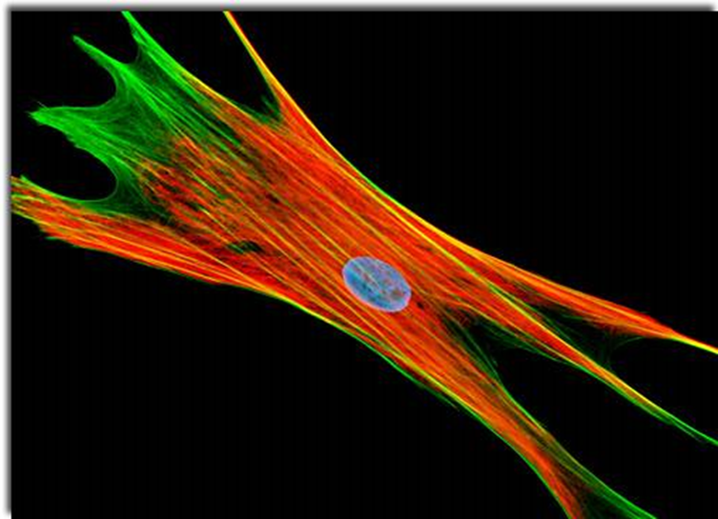
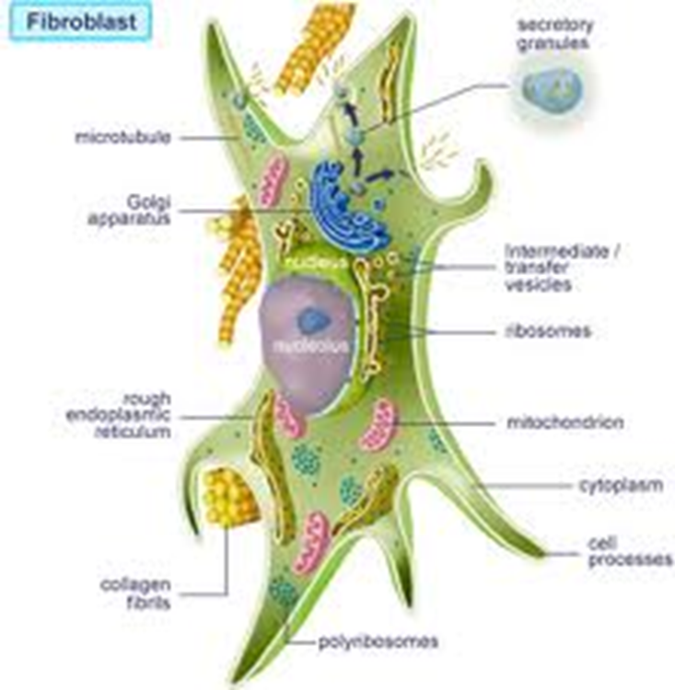
Connective Tissues: gravitational strength and support, movement
Loose Connective Tissue
Dense Irregular CT
Dense Regular CT
Elastic Connective Tissue
The Fibroblast is the cell type that secretes the ECM and makes these tissues

Slide 27
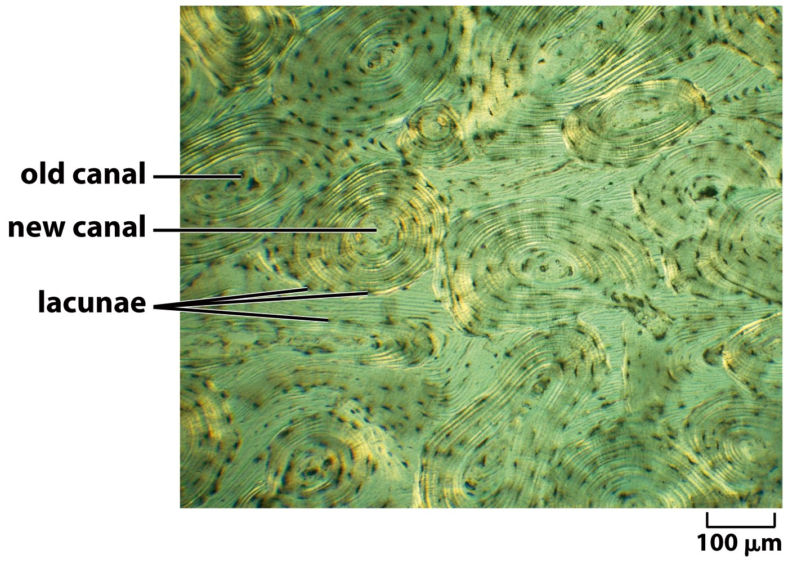
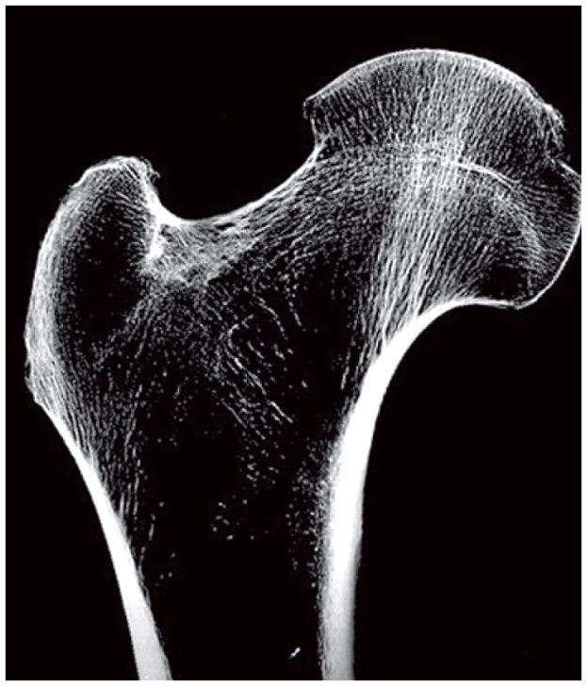
Bones are Connective Tissue
There are very few cells in bone.
The addition of calcium apatite to the ECM gives bone tensile strength

Slide 28
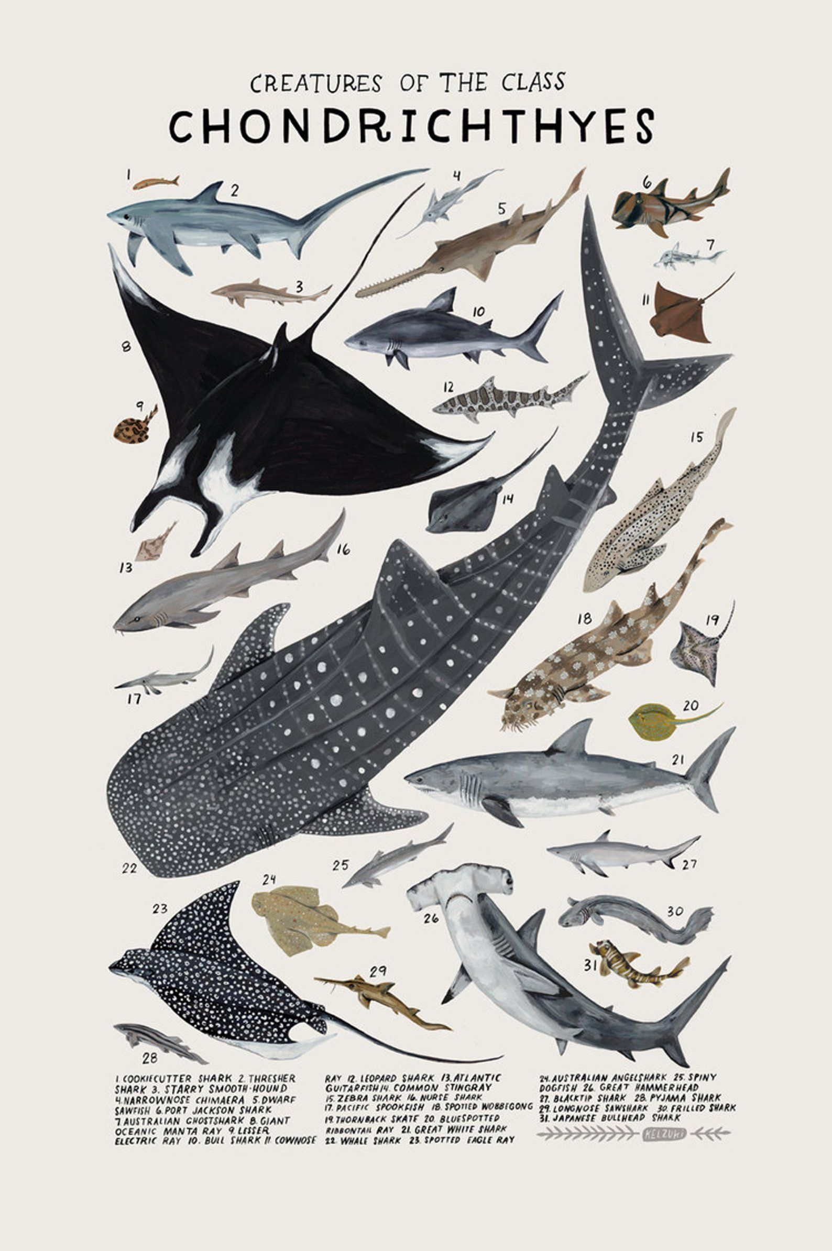
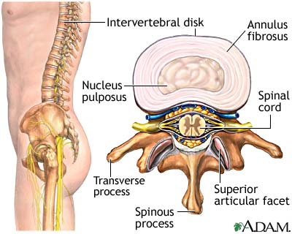
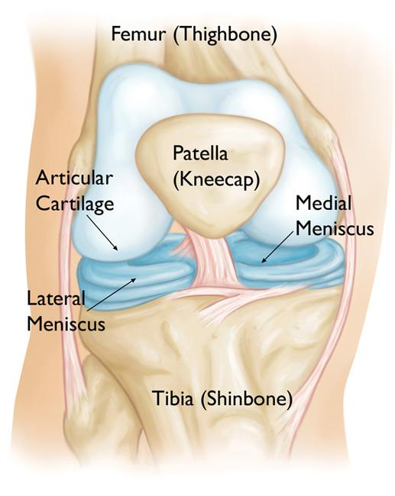
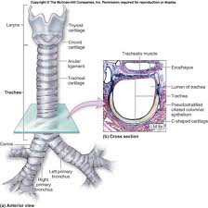
Cartilage Connective Tissues
Many ancient fishes make cartilaginous skeletons but do not calcify them.
Our bones start out that way and then we add calcium later.
Vertebral cartilage
Knee cartilage
Tracheal cartilage

Slide 29


Adipose (Fat) Tissue Connective Tissue
The adipocyte is modified to store tremendous amounts of triglycerides, cholesterol and fat soluble metabolites.

Slide 30

Muscle: voluntary movement, pumping blood, movement of materials
Figure 23-47a Molecular Biology of the Cell (© Garland Science 2008)

Slide 31


Skeletal Muscles Shorten to Bring Two Bones Closer Together
You decide you want to move
Signals from voluntary motor neurons
Calcium release activates sarcomere
Myosin ratchets actin to midline
Sliding filament theory
Requires ATP used by myosin

Slide 32


Heart muscle wraps around each of the chambers of the heart.
When stimulated to shorten, the chamber (lumen) gets smaller and the blood is forced out through a valve.
Vertebrate hearts can be categorized by the number of chambers:
Two chambers: one atrium and one ventricle (fish)
Three chambers: two atria and one ventricle (amphibian and reptile)
Four chambers: two atria and two ventricles (bird and mammal)

Slide 33

Smooth Muscle is different from skeletal and cardiac muscle in that it does not shorten end-to-end but, rather, toward the middle.
Smooth Muscle Containing Organs:
Arteries, veins
Lymphatic vessels
Gastrointestinal tract
Respiratory tract
Urinary bladder
Reproductive tract
Urinary tract
Iris of the eye
Erector pili of skin
Arranged around a fluid filled structure this leads to local movement of the material inside.
This can occur in one direction by controlling the contraction from one end of the structure to the other.
This is called peristaltic movement.

Slide 34




Nervous Tissues: movement, sensation, control of homeostasis
The Central Nervous System (CNS): Brain, spinal cord
The Peripheral Nervous System (PNS): Voluntary motor neurons, sympathetic/parasympathetic nerves, receptors
Special Sensory Organs: Ears, eyes, nose, taste
Cell types in nervous tissue

Slide 35

Tissue and Cell Types in Plants
Ground tissue is responsible for storing the carbohydrates produced by the plant, and comprises the majority of a young plant and lies between the vascular and dermal tissues.
Parenchyma cells function in photosynthesis and nutrient storage. They have thin walls, many chloroplasts, and large central vacuoles, and they form the mass of most leaves, stems, and roots.
Sclerenchyma cells are hollow with strong walls, and they help strengthen the ground tissue.
Vascular tissues include xylem, which conducts water and minerals from the roots upward and throughout the plant, and phloem, which transports dissolved nutrients in all directions within the plant.
Dermal tissue covers and protects the plant, and controls gas exchange and water absorption (in roots).

